Slide 1
Theme-Based Instruction in Teaching English to Young Learners 2016-2018
Theme: FREE TIME
by Katarina Mihajlovic Ilic, Irena Delic and Jelena Jevtovic
..\..\Downloads\TBI UNIT PLAN - FREE TIME.docx

Slide 2
Student Profile
Young learners, ages 10 - 11, in their fourth year of English (Grade IV)
Language Objectives
Grammar: Verb+ing, Present Simple, Numbers
Vocabulary:
playground vocabulary (seesaw, skip, slide, roundabout, springy, climbing frame, sandpit….)
sports vocabulary
free time activities (ride a bike, watch films, play computer games, do a jigsaw puzzle, go out, collect stickers, break a record, to do the jumps, to hula hoop, blow biggest bubbles, to balance spoons…)
Content Objectives
identify different numbers (1-100, additionally 1000 and some examples of complex numbers 58.5)
identify different free-time activities
expressing likes and dislikes
using the present simple and “verb+ing” form in a given context and communication

Slide 3
Language Skills
Listening:
- listen to a song “Playing in the Playground”
- listen to a story “Record Breakers”
- listen to the short texts “Free time activities”
Speaking:
- talk about free time activities
- talk about what they like and don’t like doing in their free time using the presented structures
-talk about free time activities and record breakers
- ask and answer questions about the story (“Record Breakers”)
- sing a song “Playing in the Playground”
Reading:
- read the texts and tick the correct pictures
- read mixed parts of the story and put them in the right order
- match playground activities with their names/ flashcards with words
-match the key words with their written forms
-match the figures with the right sentences
Writing:
-write about their friends’ favourite activities
- write the missing letters (numbers)
-correct the mistakes in the sentences
- write about their favourite free time activities

Slide 4
Lesson 1: At the playground
Warm up: The playground flashcards
Hold up the ‘swings’ picture card and say ‘I like playing on the swings. Do you like the swings?’ Tell the students to put up their hand if they like playing on the swings.’ Do the same with the other picture cards.
Now ask the students to listen and repeat the playground words after you as you show them the cards. Spread out the picture and word cards face up on the floor. Ask for volunteers to match the pictures with the correct words. Now put all the picture and word cards face down on the floor. Invite students to choose two cards. Can they find matching pairs?

Slide 5
Presentation: Song Playing in the playground
http://learnenglishkids.britishcouncil.org/en/songs/playing-the-playground
The children tell you playground activities in English (playing on the swings, playing football…etc) and write them on the board.
Play the song and ask children to stand up each time they hear one of the activities on the board. Play the song again – this time the children follow the words and join in with just the last word of each line. Play the song again and encourage the children to sing along. You can make up actions (swinging, playing football, laughing etc) for the song as you all sing along.

Slide 6
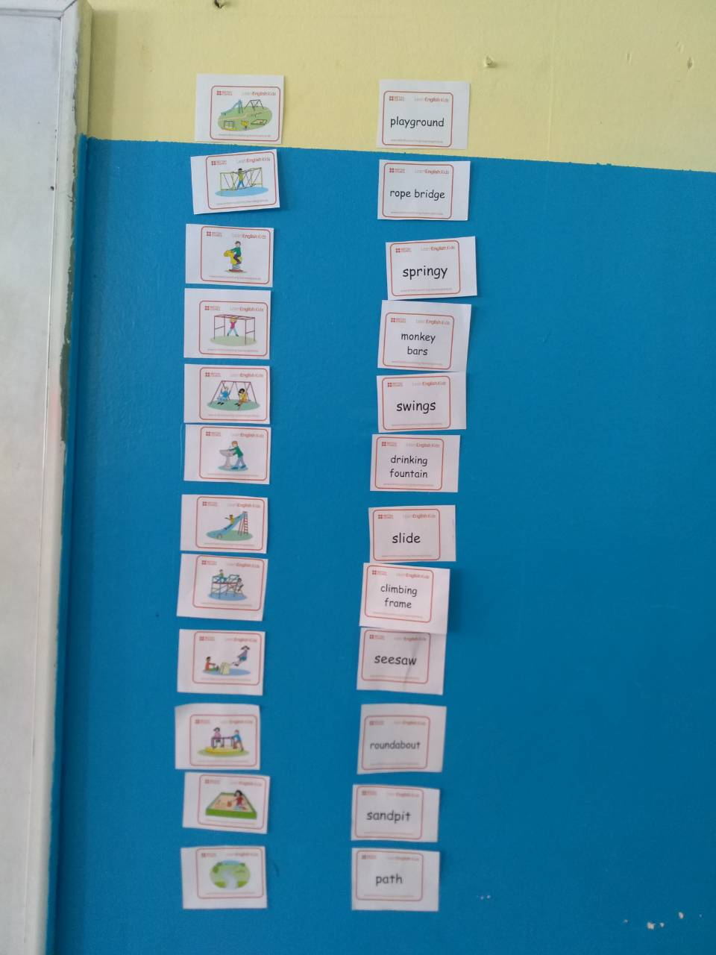
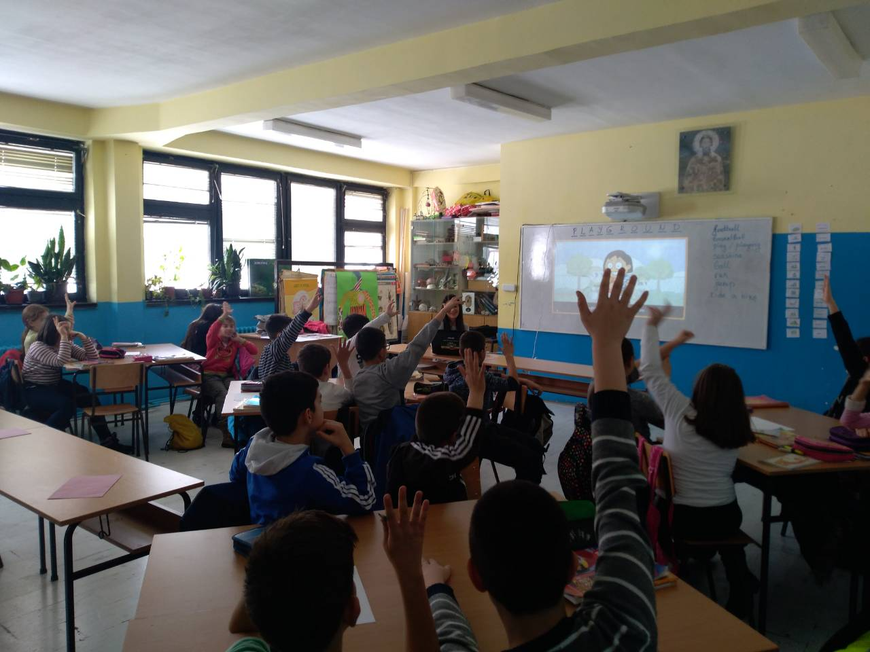
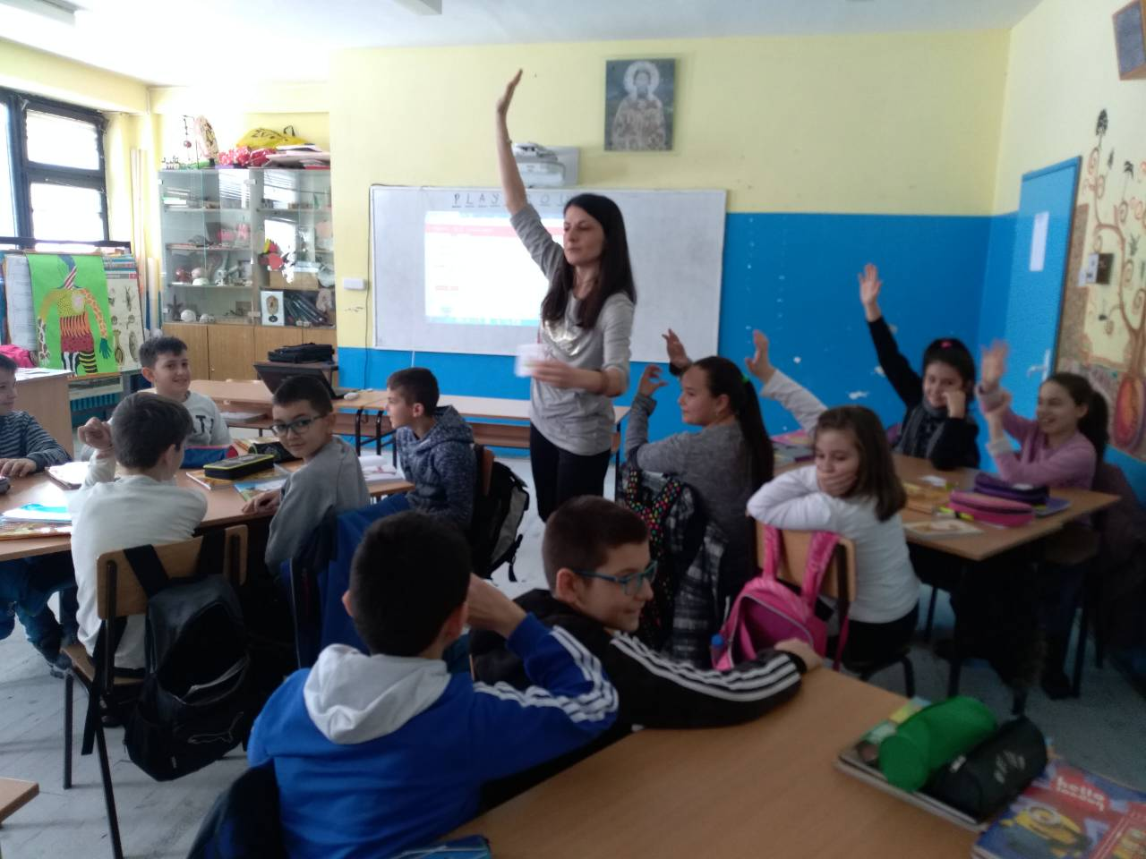
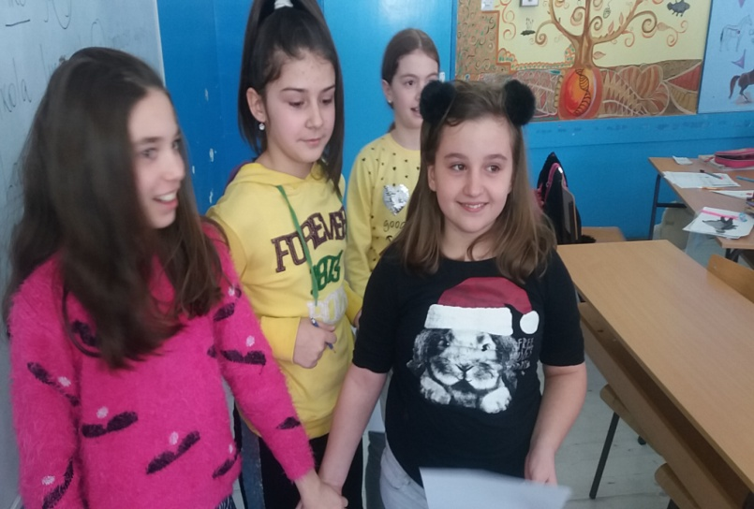

Slide 7
Practice
Activity 1: What’s the order?
Listen to the song again and put the lines into the correct order
Activity 2: I like/don’t like
Ss say what they like/do not like (“I like going down the slide”)
Application
Activity 1: Draw and describe
Ss draw three of their friends doing the activities they like at the playground and below each picture write “ ________likes playing in the sandpit”. They do not write the names.
Activity 2: Gallery walk
They stick their drawings to the wall all around the classroom and do a gallery walk. They also try to guess and write the names of their friends represented in Other Ss’ drawings.
Follow up: Vocab Refresher (Ss make list of all the words from the lesson. In pairs they use the lists to elicit the answers from their partners using explanations, gestures, mimics or demonstration)

Slide 8
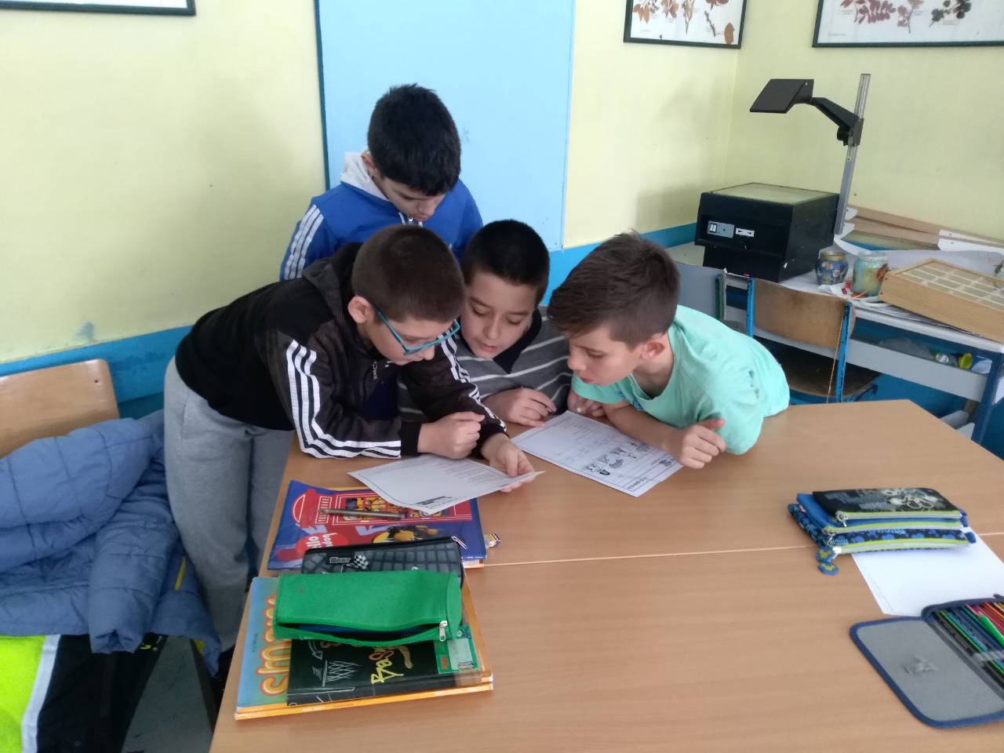
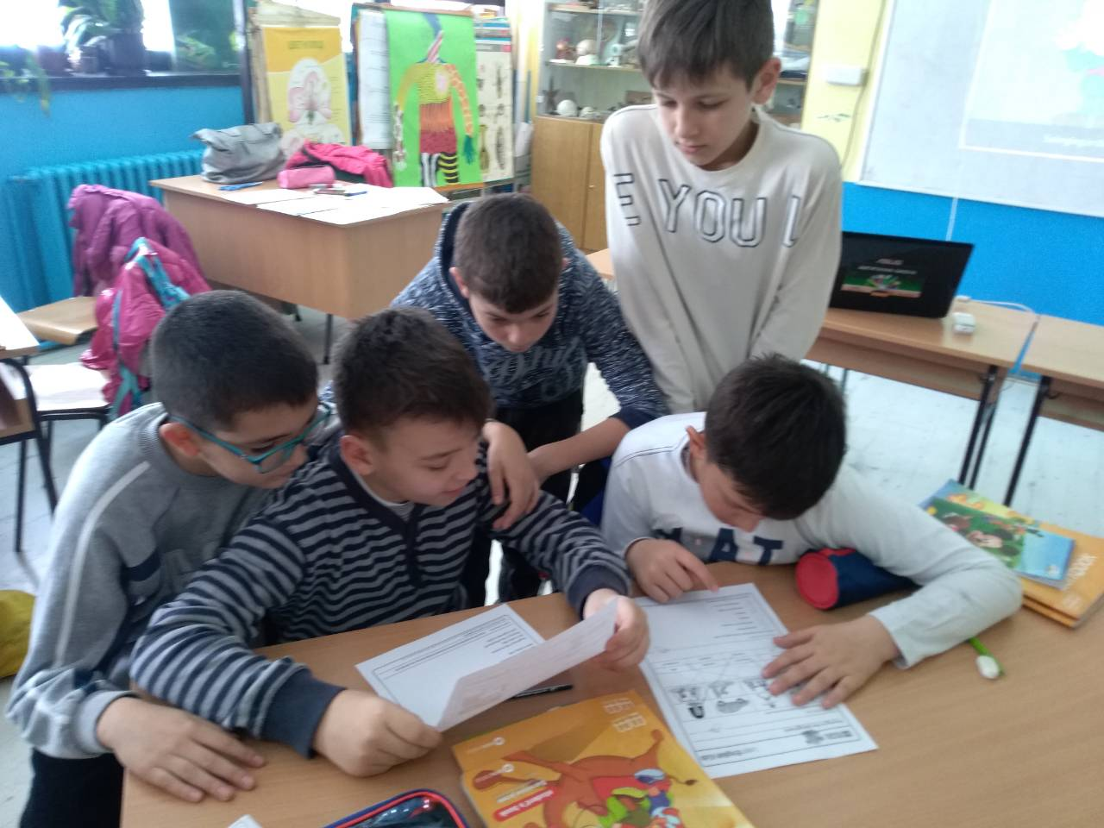
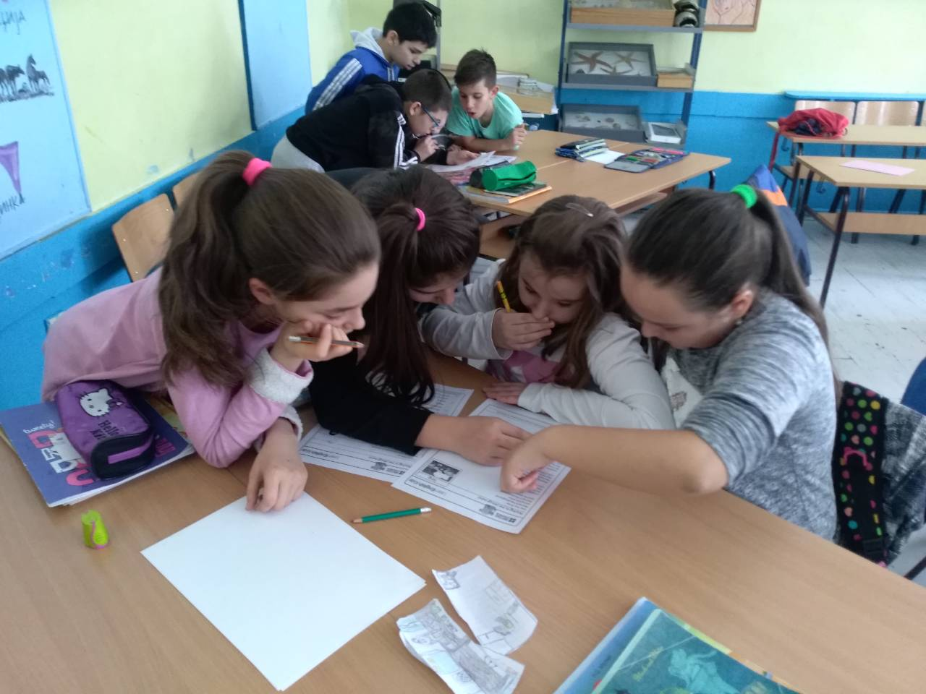
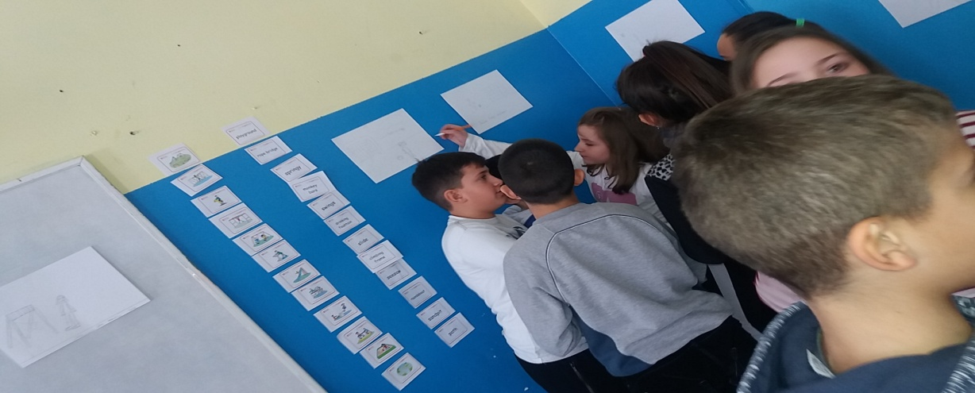
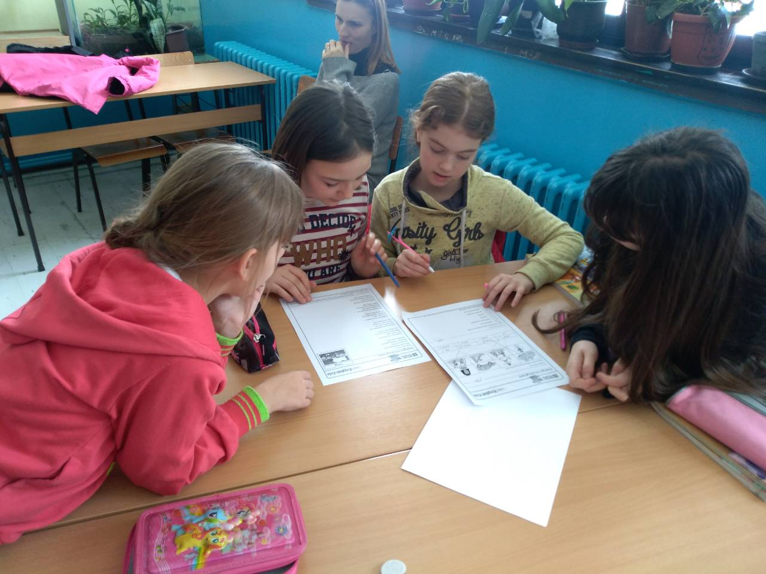

Slide 9
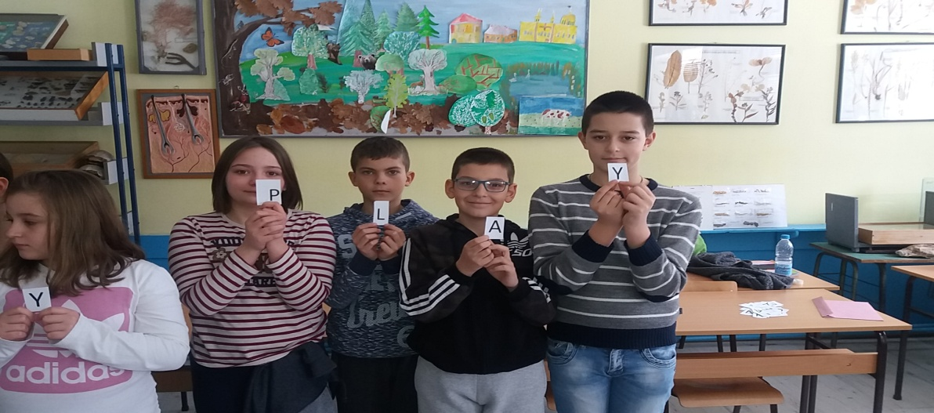
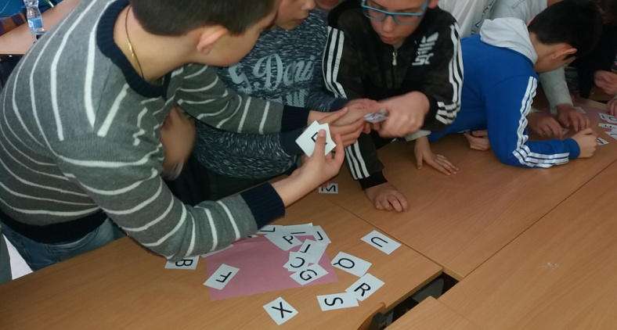
Lesson 2: No Dogs!
Warm up
Game: Alphabet race
The Ss are divided into three teams. The teacher calls out a word related to the free time vocabulary from the previous lesson (e.g. SLIDE, PLAY, SPRINGY…). Within their respective groups the Ss have to agree on how the word is spelled and depending on how many letters the word contains, send the specific number of members to run to a table with letters. The winner is the group who finds all the letters and forms the word correctly holding the letters in their hands.

Slide 10
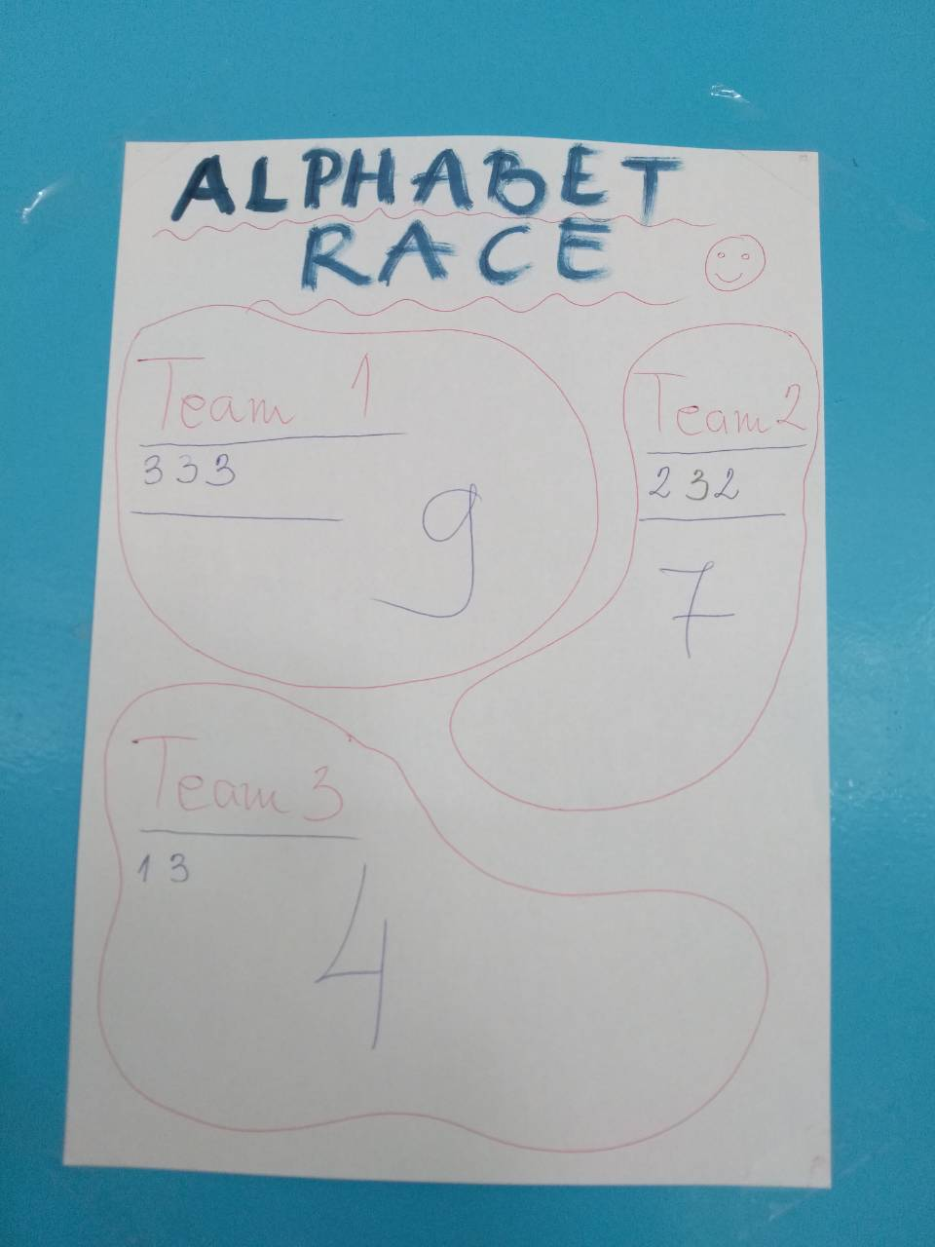
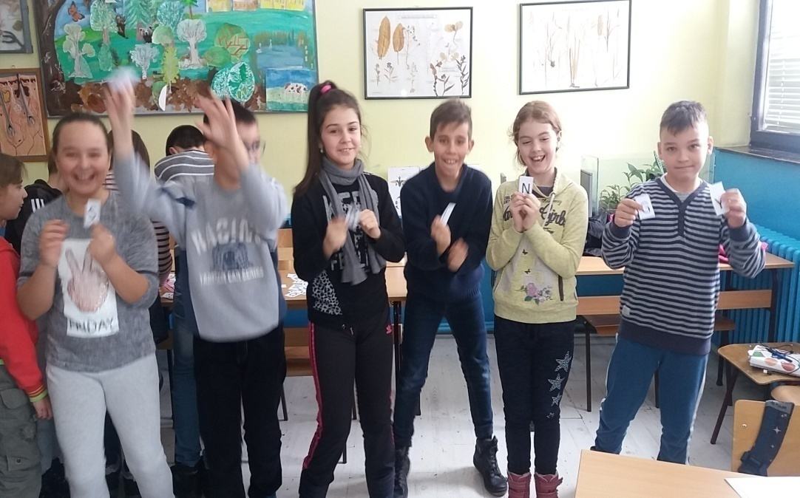
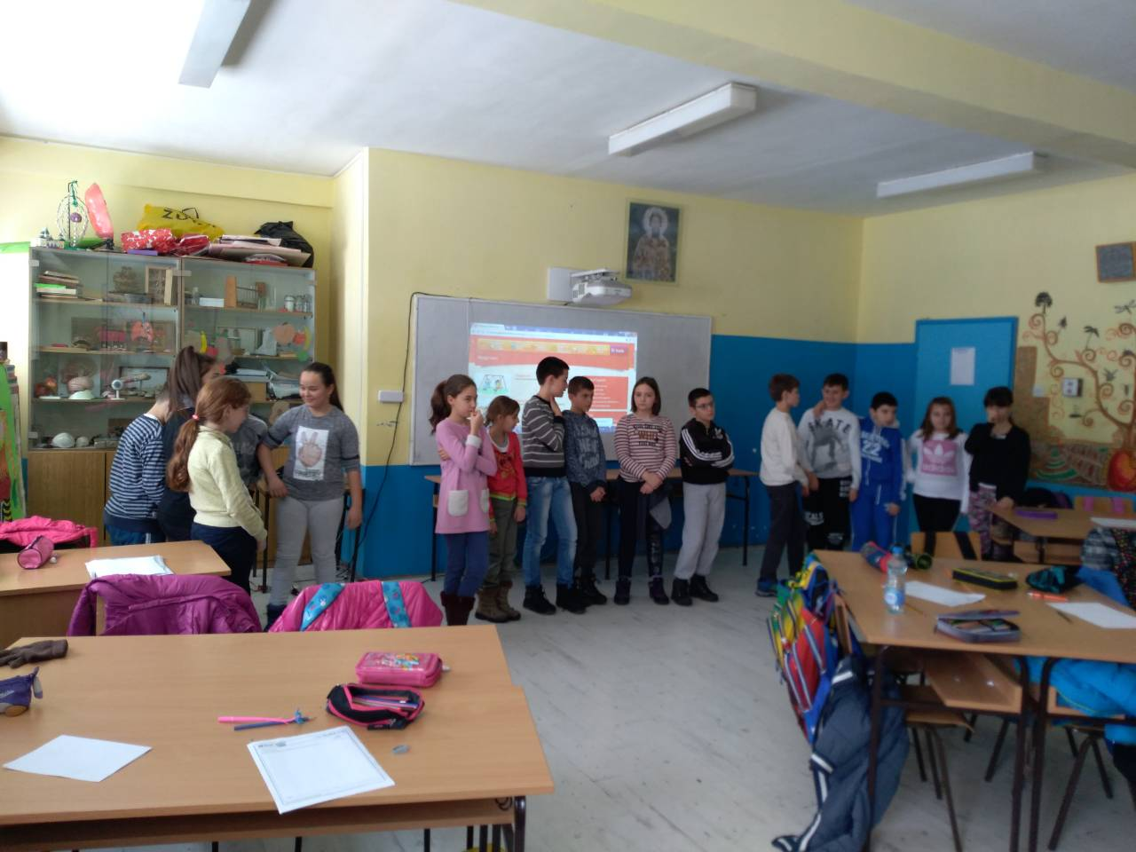

Slide 11
Presentation Story “No Dogs”
http://learnenglishkids.britishcouncil.org/en/short-stories/no-dogs
Practice
What’s the word?
In pairs, the Ss write a word below each picture gate, park, ladder... (Handout 1)
What’s the order?
The Ss watch the video once more and put the sentences about the story
( Handout 2) into the correct order. The T will adapt the sentences - present simple tense. They do this divided into 4 groups.
Application
Match them up
The Ss make sentences related to the story - match the first and the second part of the sentence. Four groups.
Assessment
The groups switch the “Match them up” handouts, check each others’ answers and correct mistakes. The T monitors, helps and corrects if necessary.
Follow-up - Act out the story!

Slide 12
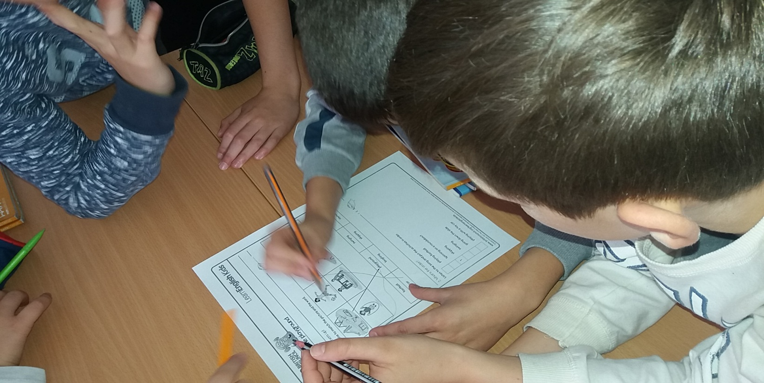
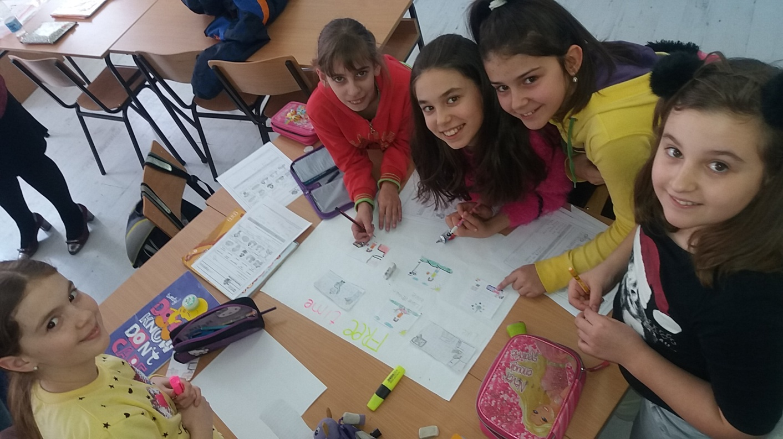
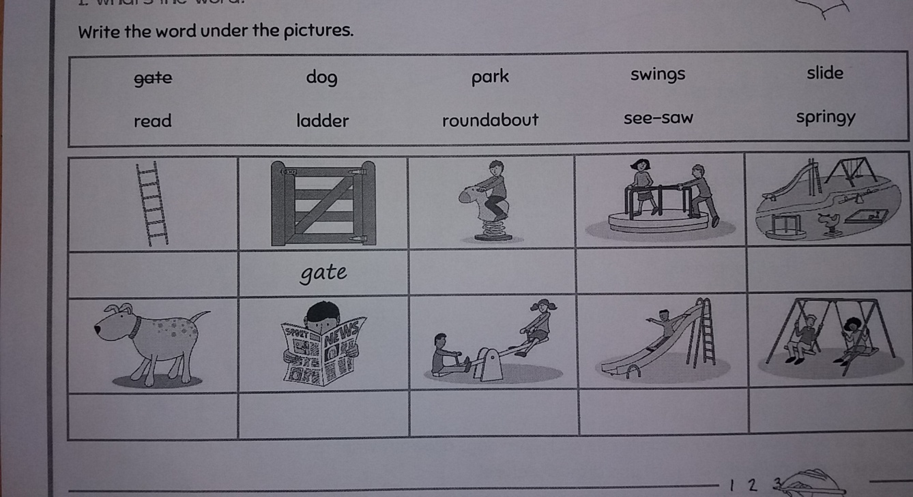

Slide 13
Lesson 3: Record Breakers
Warm up – Let’s play with numbers
Presentation
Story: Record Breakers
https://learnenglishkids.britishcouncil.org/en/short-stories/record-breakers
The students are divided into groups by counting 5-10-15-20-25. They change the places and get ready for the next activities. Teacher gives the students the sheets with the tasks.
Match and label
Teacher shows the students the flashcards with pictures of jump, spoon, hula hoop, birthday, face, bubble and elicits from the students what they think is presented on the flashcards. The teacher gives the copies of the tasks to the students and explains to them that they are supposed to match the given words with the pictures and to write them in the right place.
Video1
Children watch the video. After having listened to the story, they do TASK2 (matching figures with the right sentences)

Slide 14
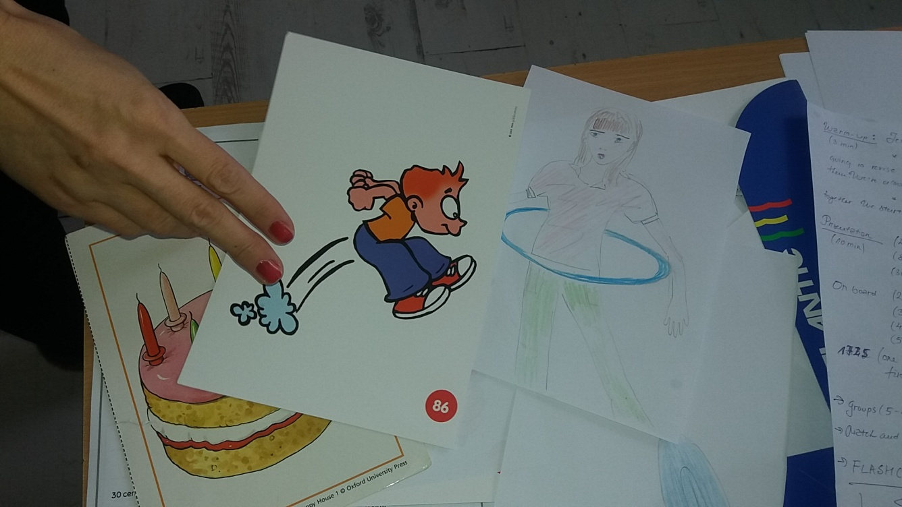
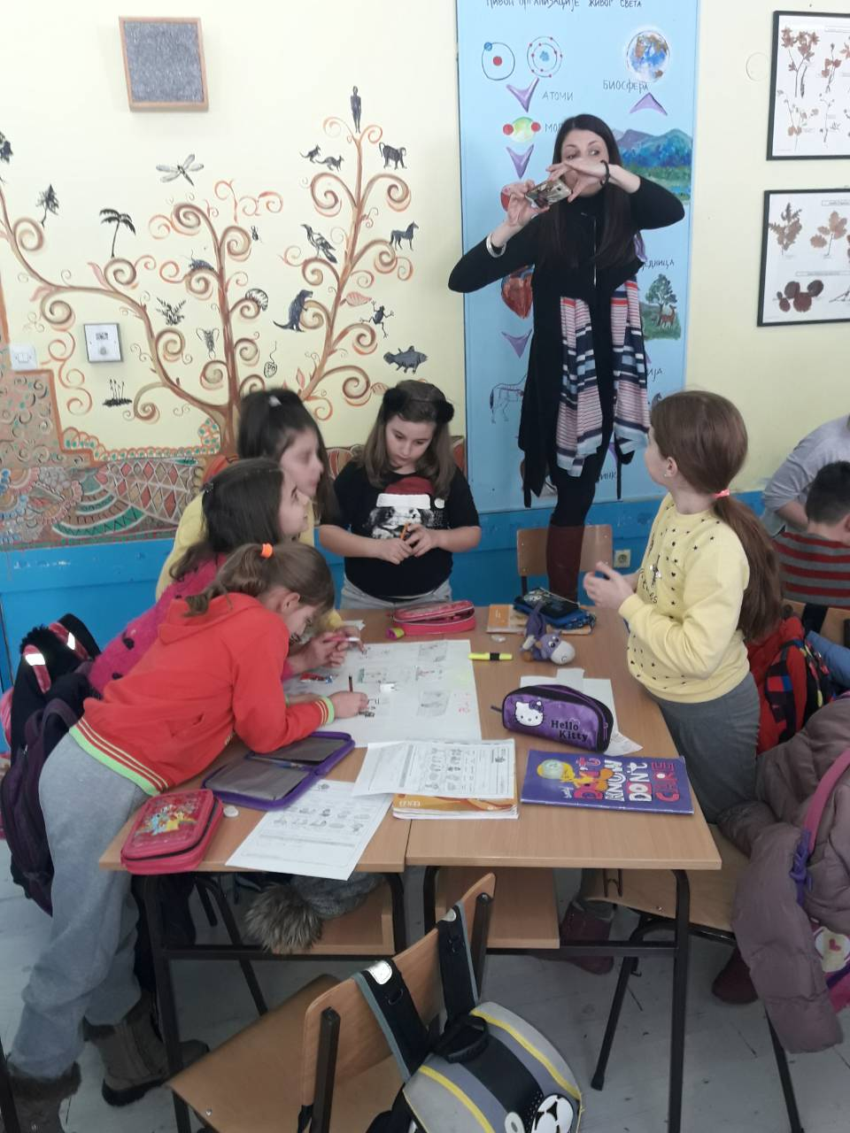
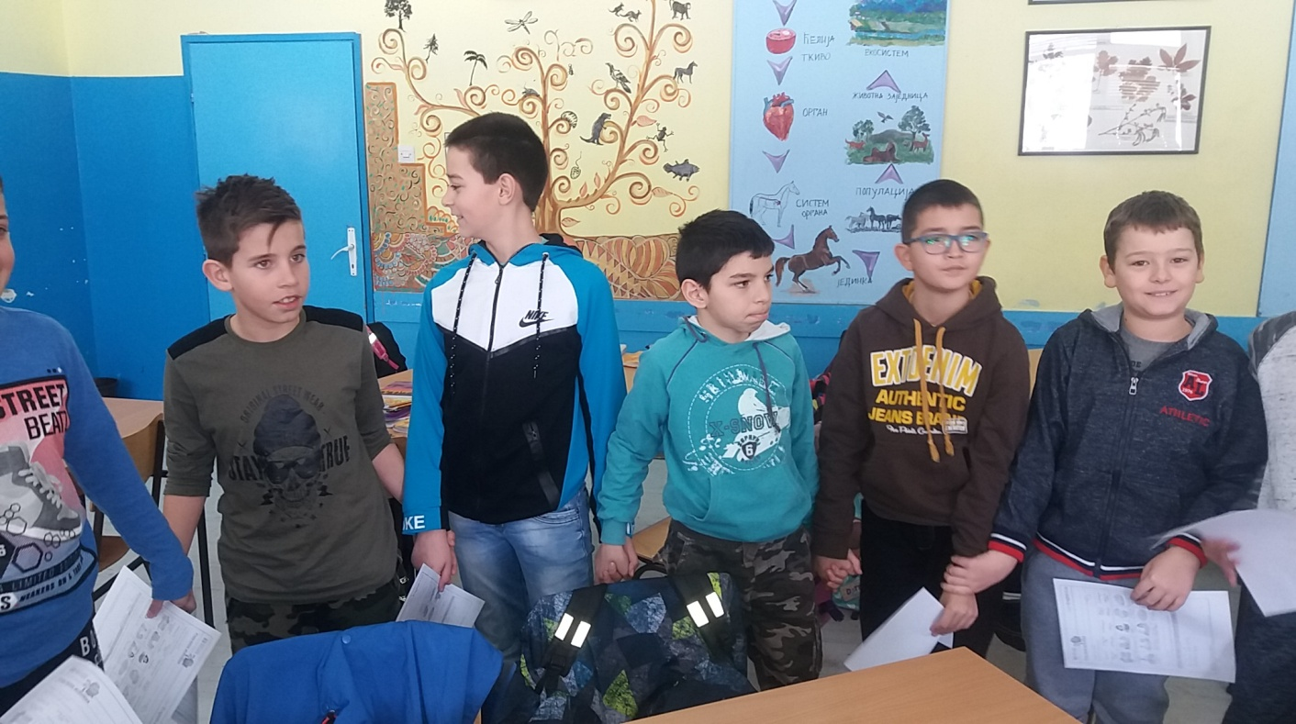
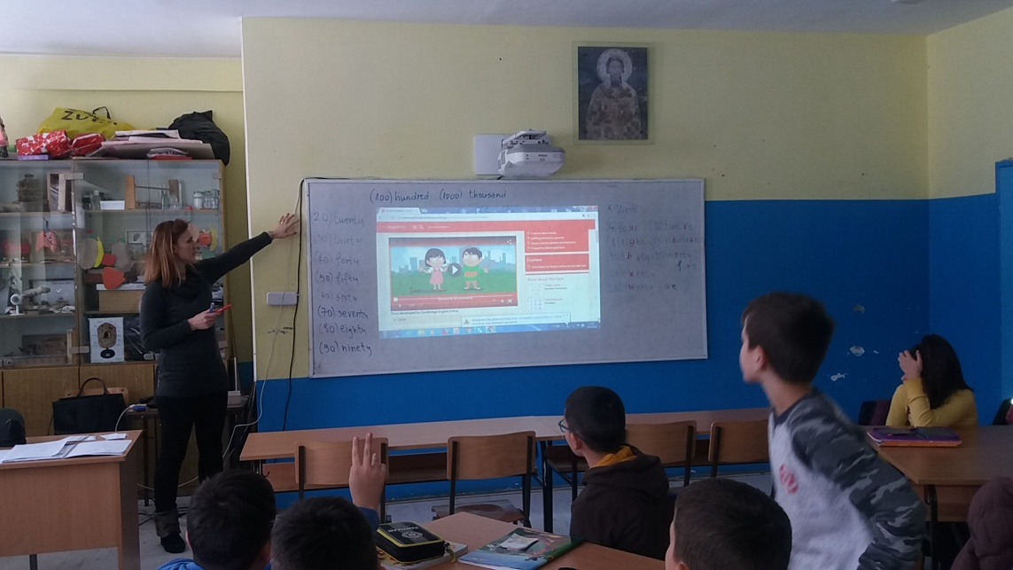
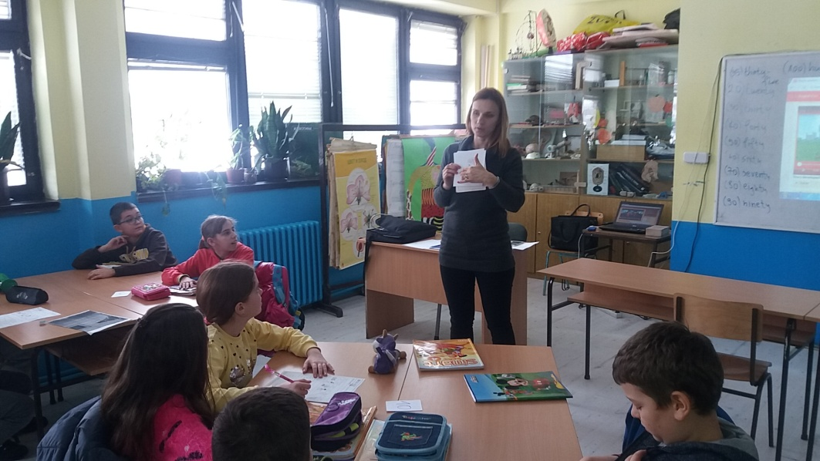

Slide 15
Practice
Video 2 –Activity 1:Find and correct mistakes (students are given a set of sentences and are supposed to spot a mistake in each example and write the right word in the appropriate place)
Activity 2: Watch the video again and answer the questions (the students are given a set of questions they can see clearly on the board and should give the right answers. Teacher encourages students to discuss the questions)
Application
Put the story in the right order: each team is given a part of the story with mixed sentences. They should arrange them the right way. They should find the order of the parts by using mime and gestures.
When they are sure about the order of the teams every team reads its part.
Assessment
Body number and mime records: each team is given a world record they are supposed to present. It consist of number and a word or a phrase e.g. 99 hula hoops, 15 spoons on the face. They should use body numbers and mime to present them. Other teams should guess what world record is present. The team with the greatest number of guesses is the winner.
Follow-up
What is the world record you would like to make?
Students share ideas about the world records they think maybe can be won and they maybe can win.

Slide 16
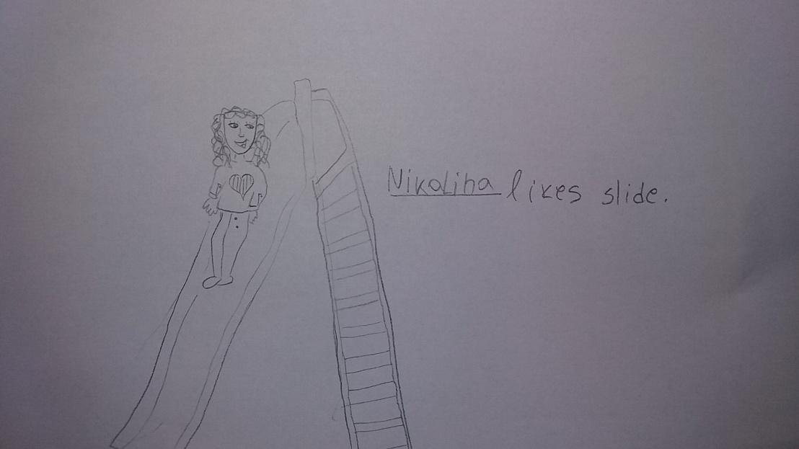
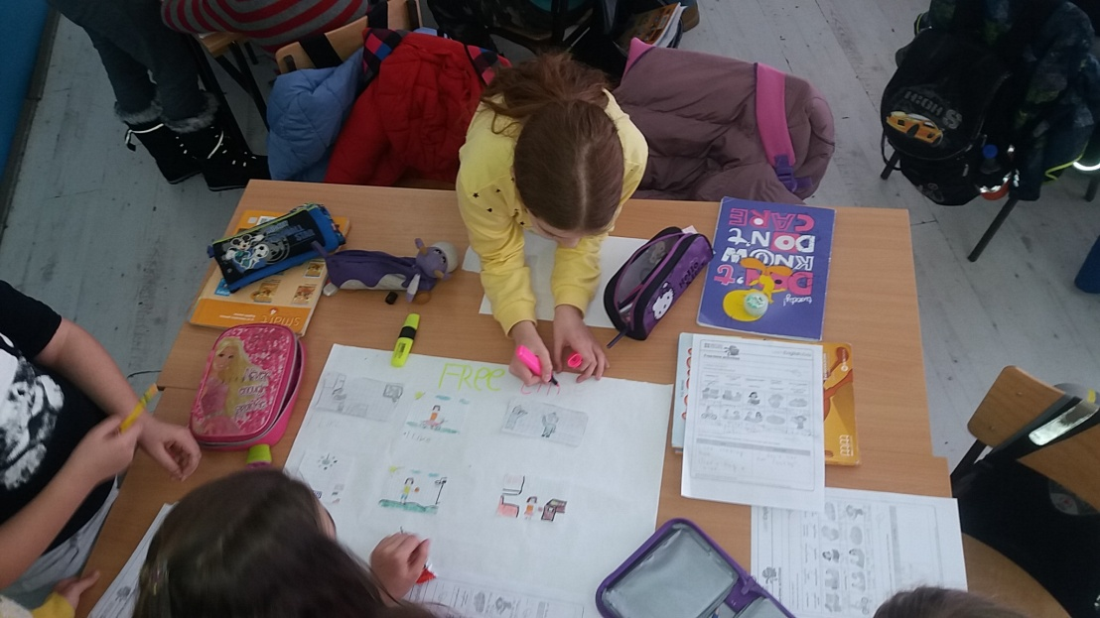
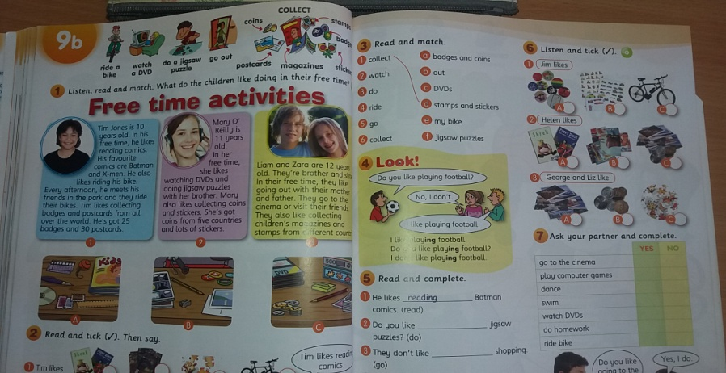
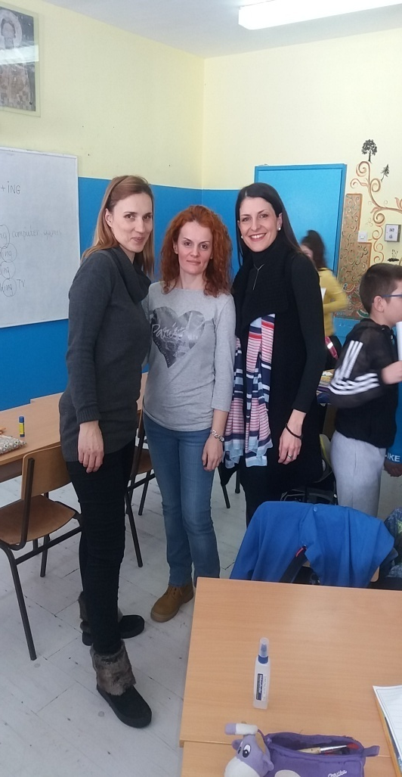
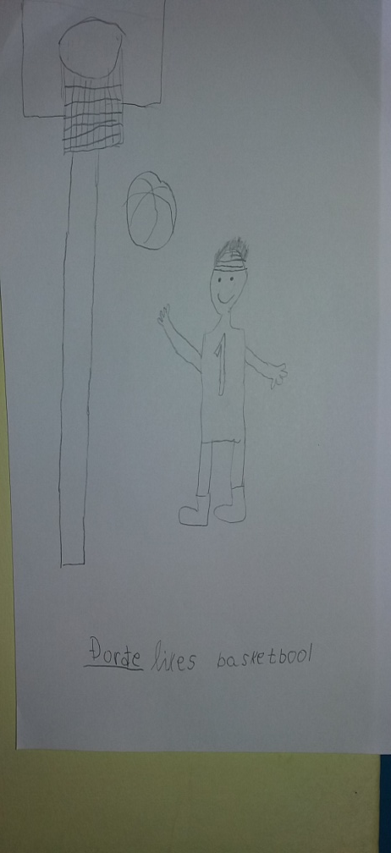
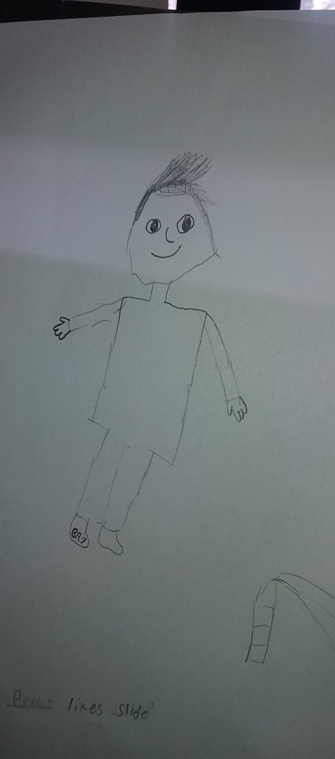
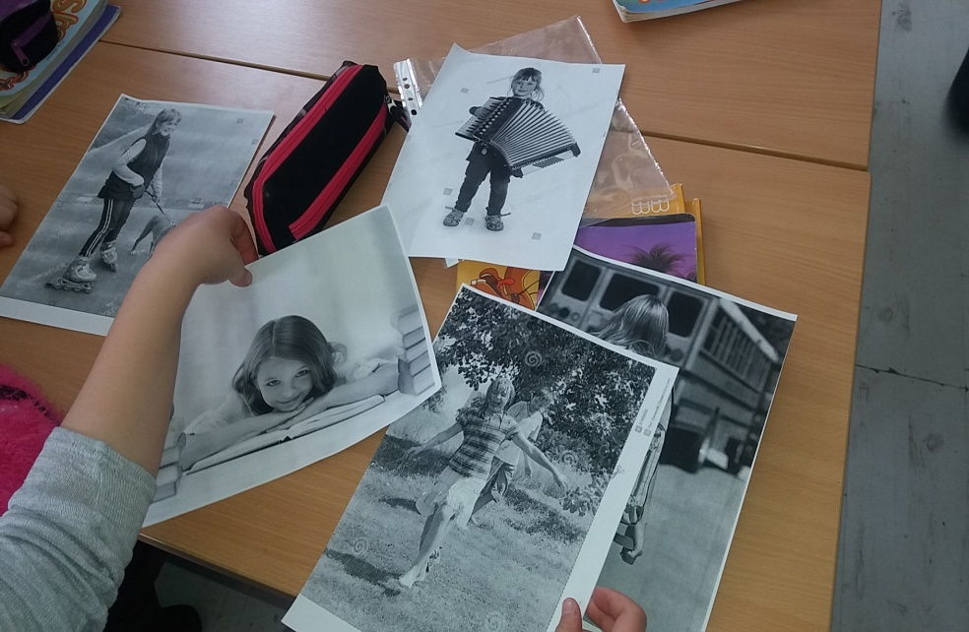

Slide 17
Lesson 4: What about you?
Warm-up
Let’s revise
Teacher tells Ss that they are going to talk about free time and says “In my free time I like ….” and writes the sentence on the board. T encourages Ss to remember activities from the previous lessons and make their own sentences. Write some of them on the board.
Together they analyse the sentences and LIKE+VERB+ING form.
Presentation
Activity 1: Free time activities vocabulary
Activity2: Listen and match
Practice
Activity 1: Read and tick
Activity 2: Match

Slide 18
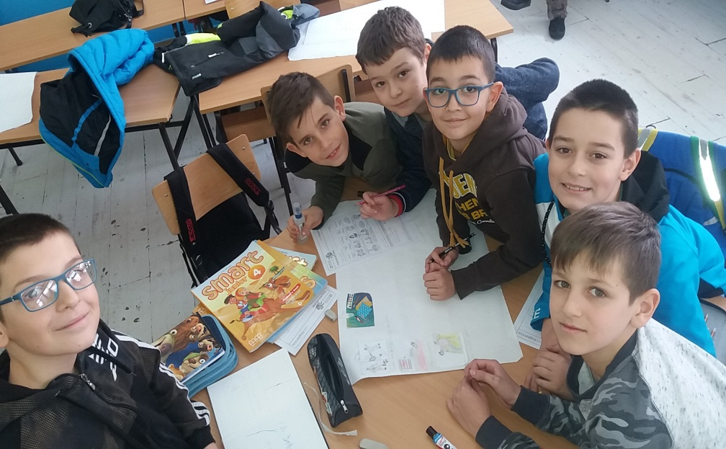
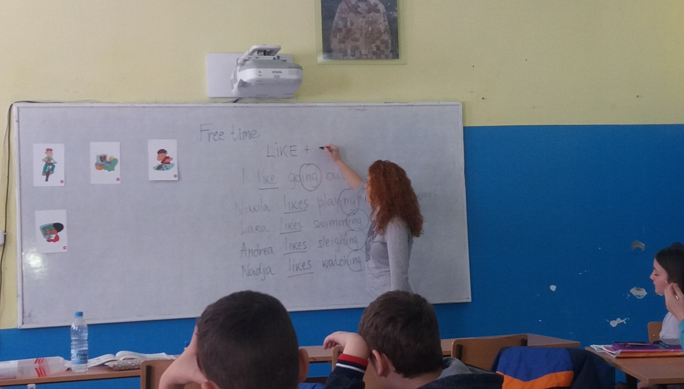
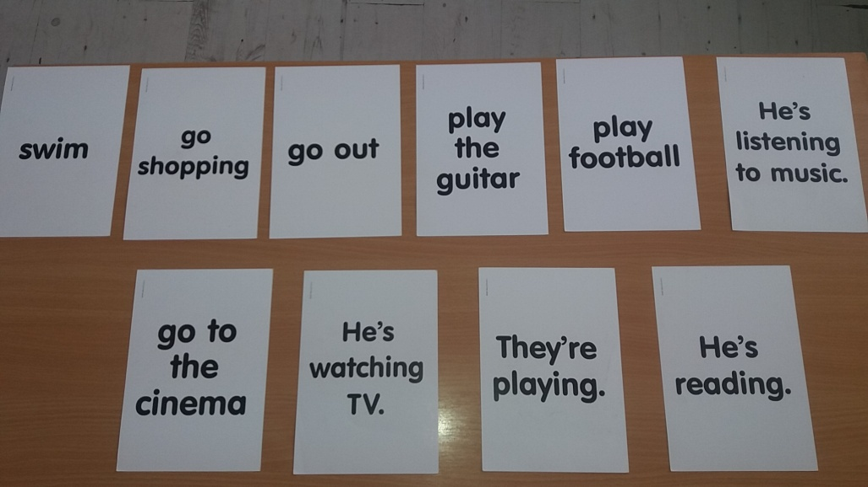
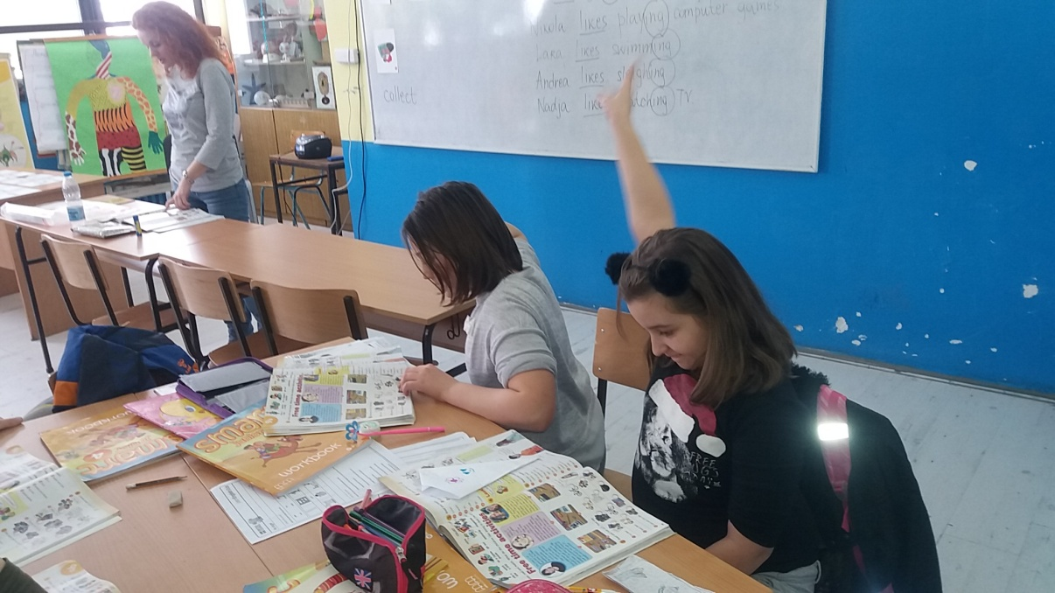
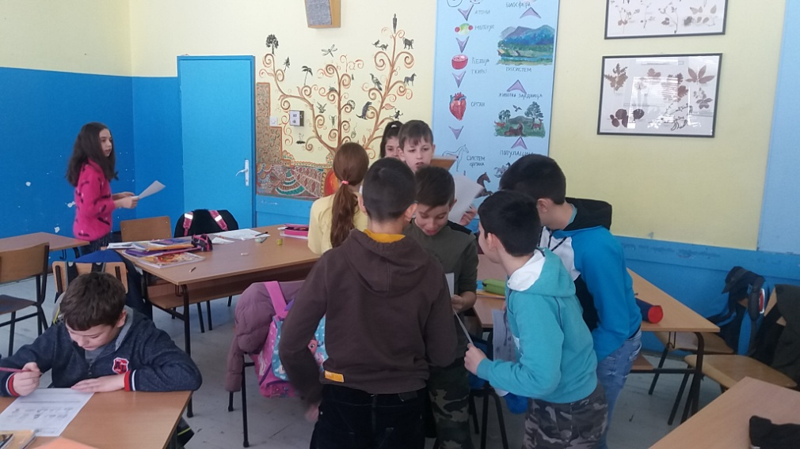

Slide 19
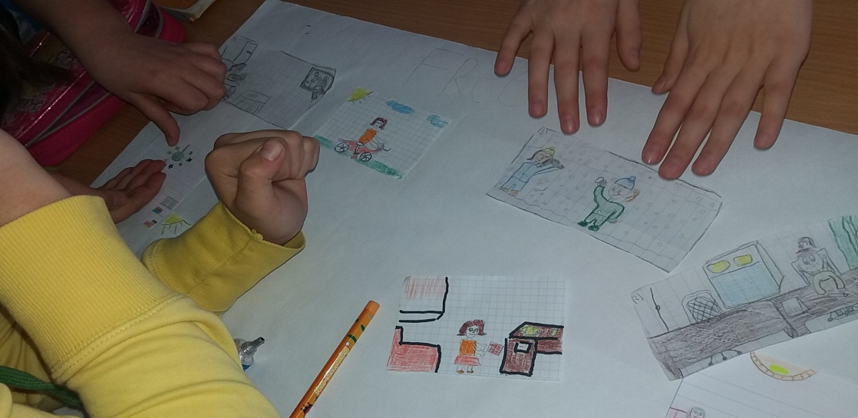
Application
What about you
Ss get a table that contains different free time activities and LIKE/DON’T LIKE columns. First they have to tick the corresponding boxes for themselves. Then they have to ask each other about the same activities “Do you like going to the cinema?” and find someone who likes the same things. They make groups according to their likes.
Group work
Ss do a project about their favourite free time activities.
Follow up - Chain game

Slide 20
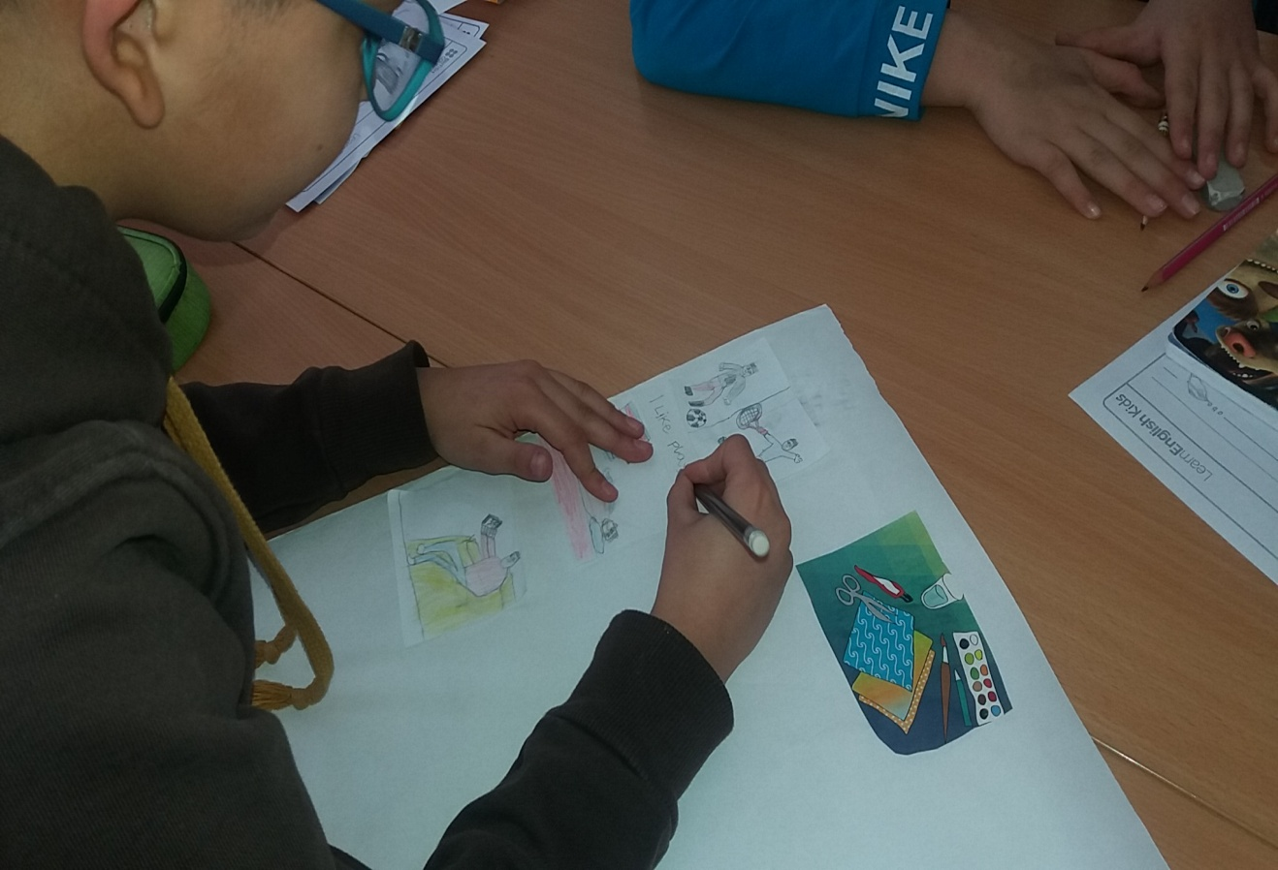
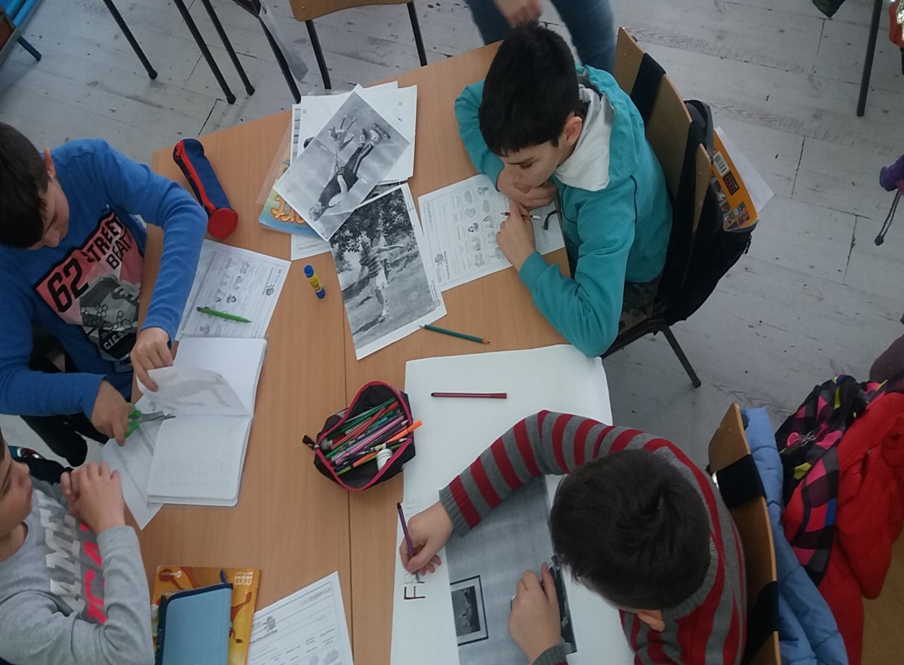

Slide 21
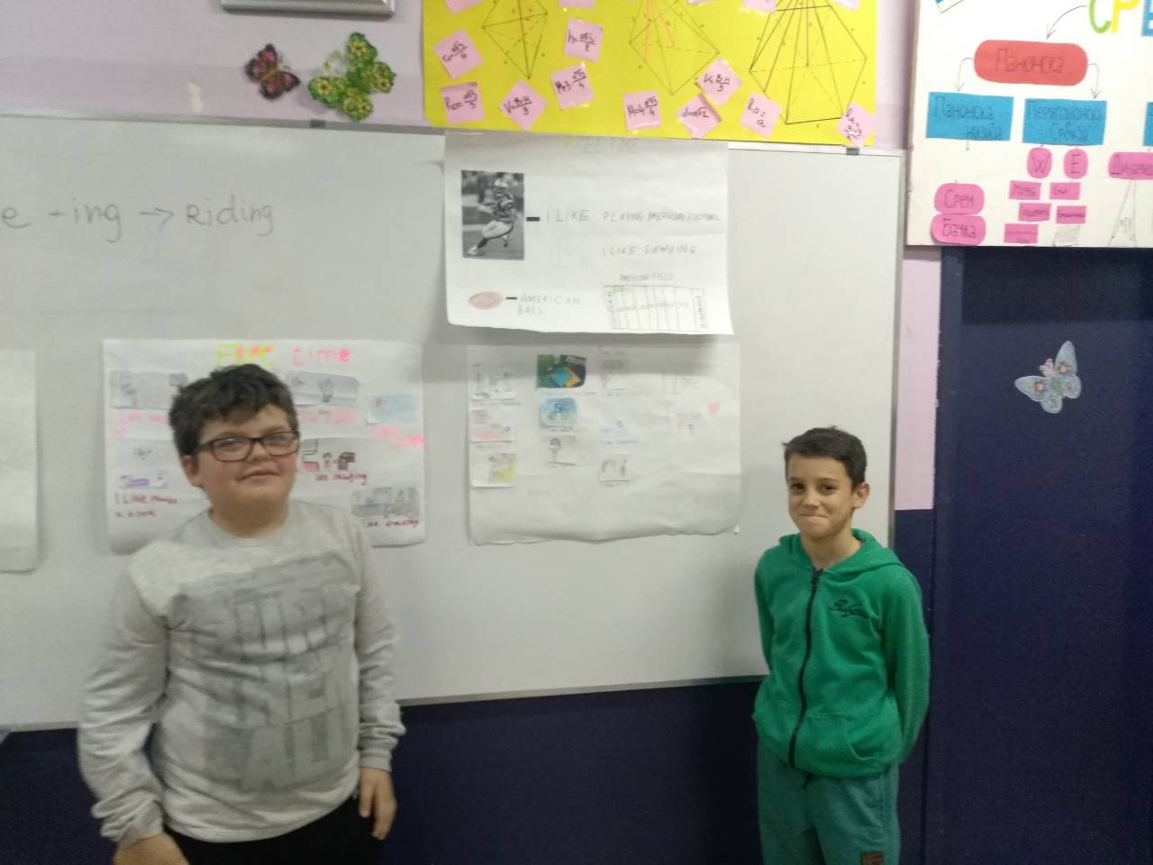
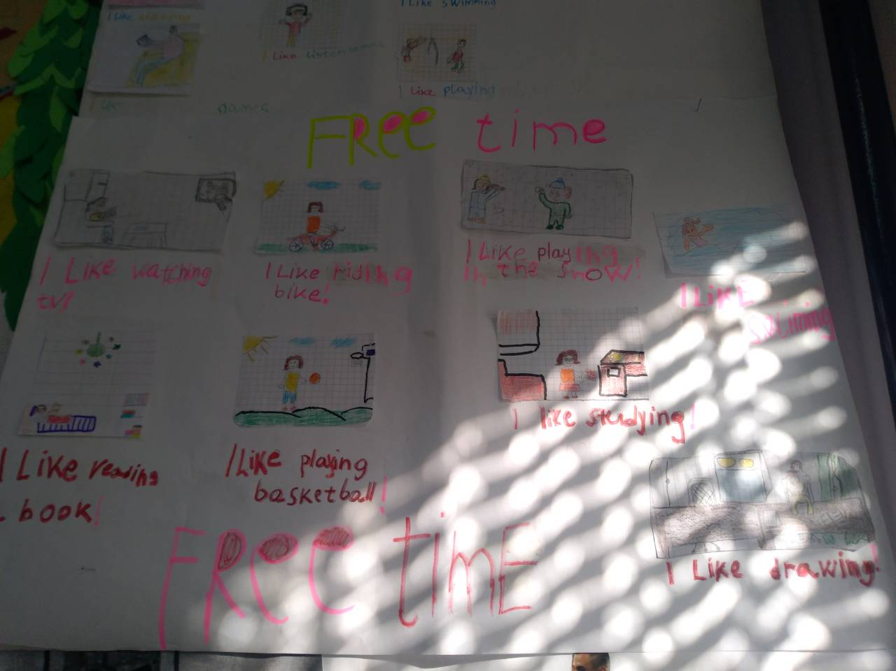
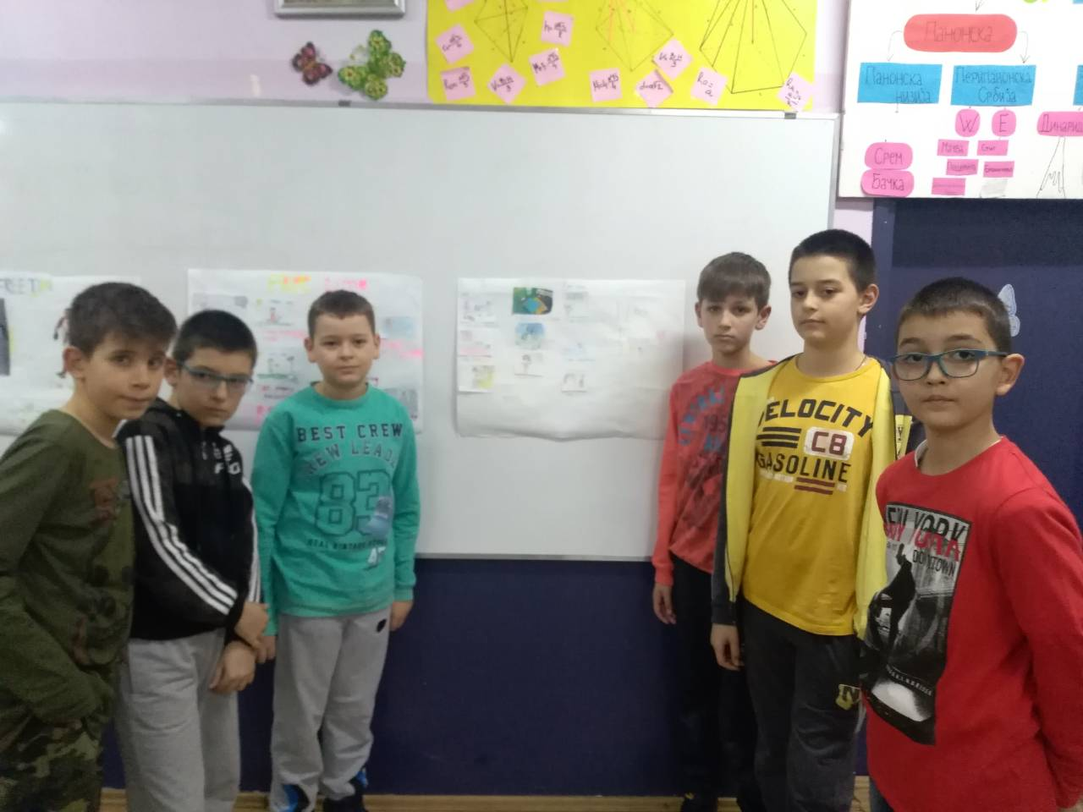

Slide 22
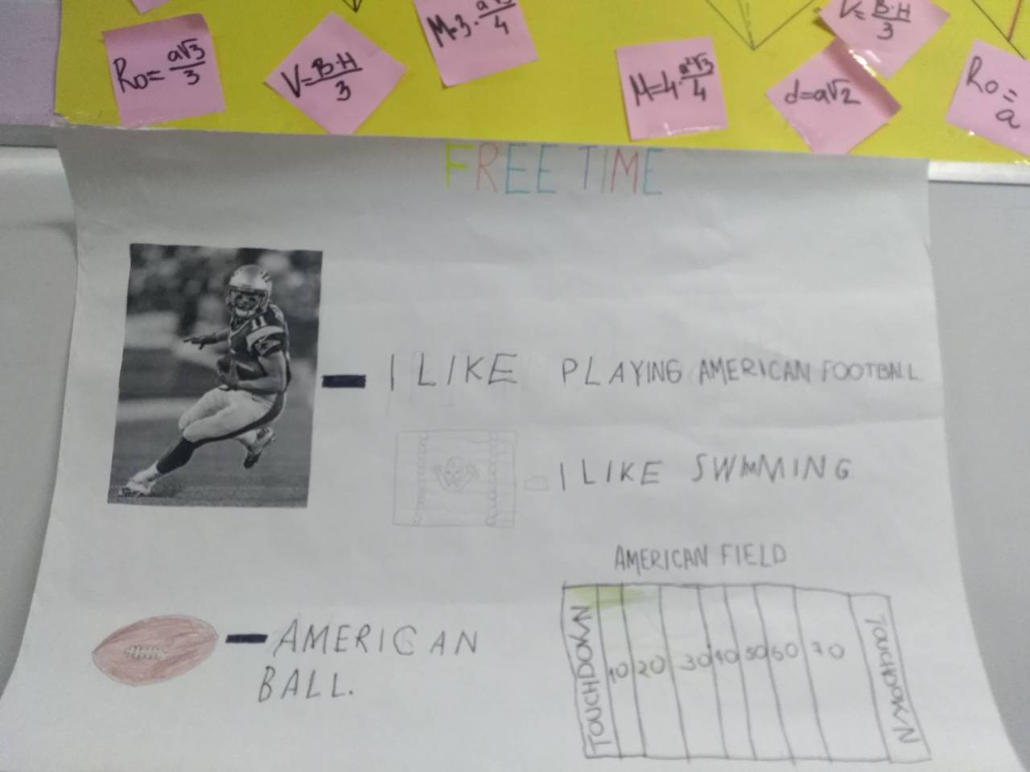
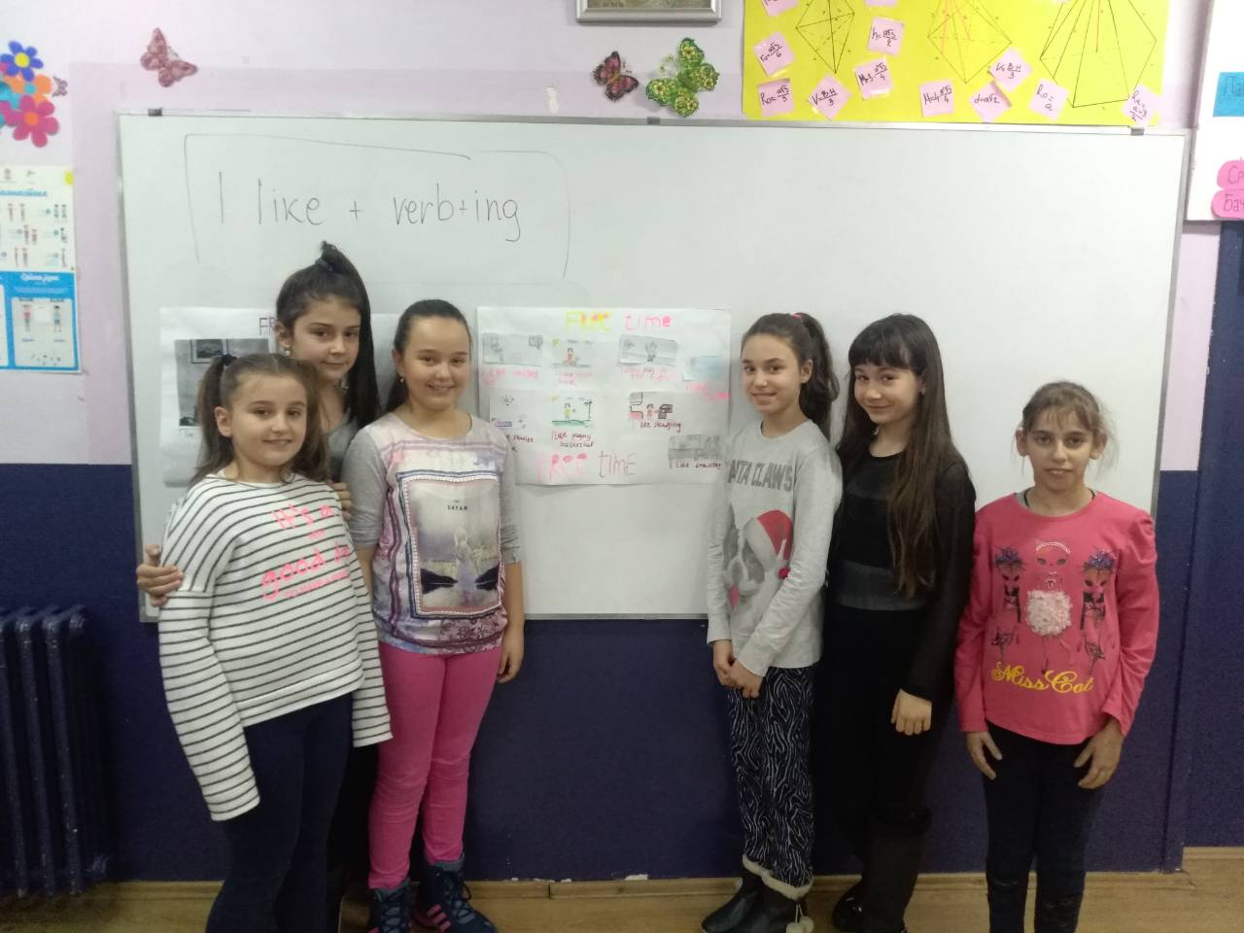
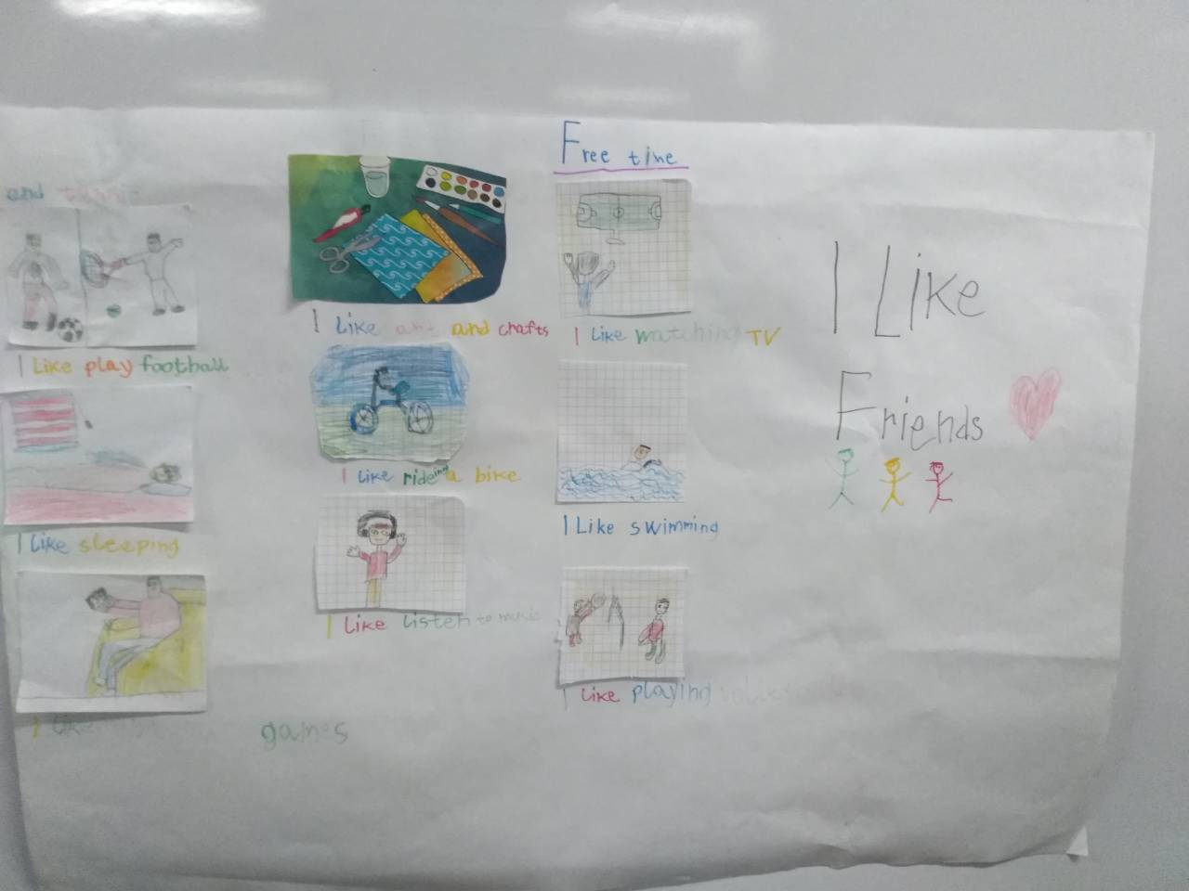
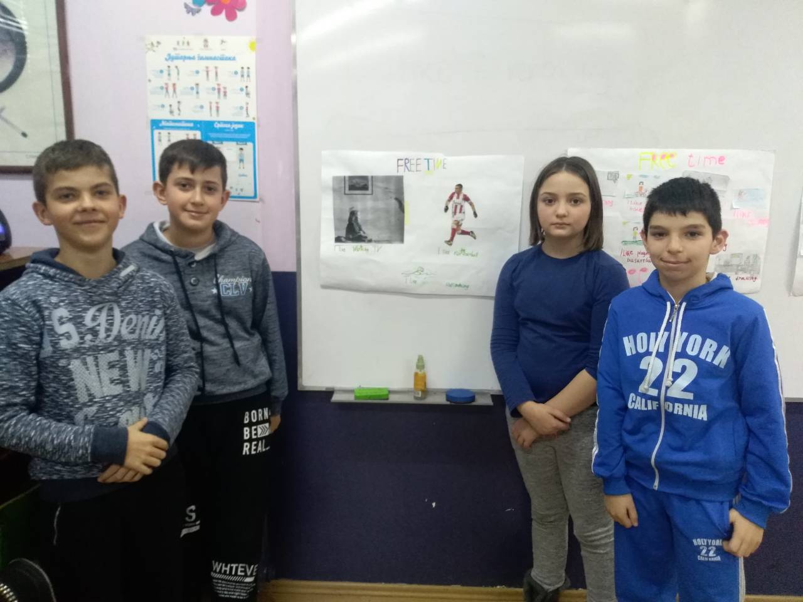

Slide 23
Thank you! Irena Kaca Jelena

